Slide 1
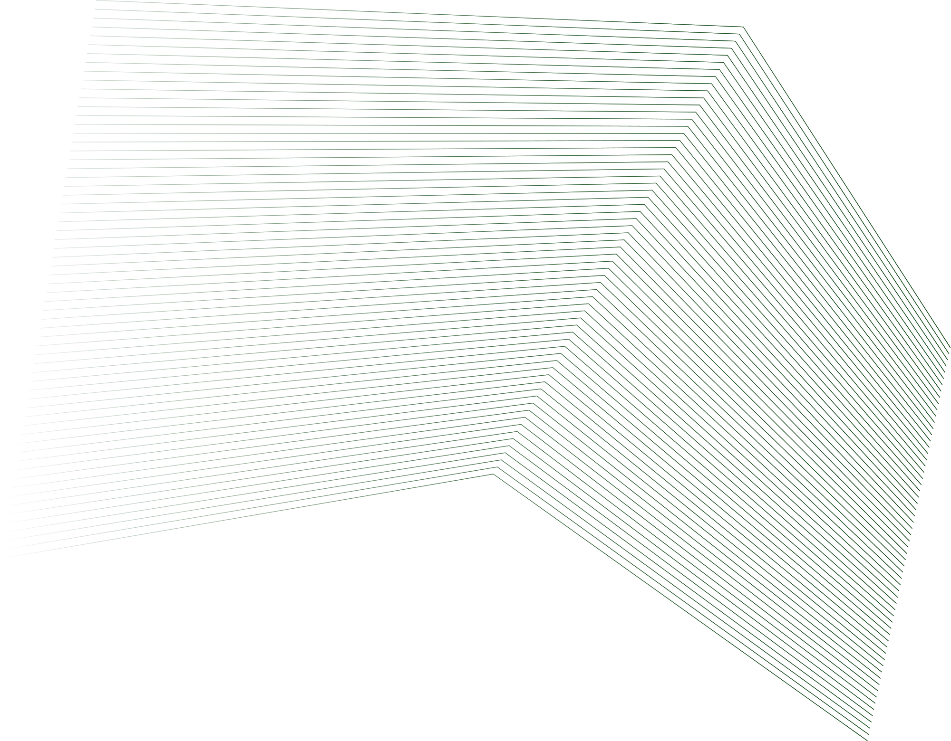
DATA VISUALIZATION: PIE CHARTS AND OPENGL
Programming assignment on fruit preference survey
GROUP 9

Slide 2
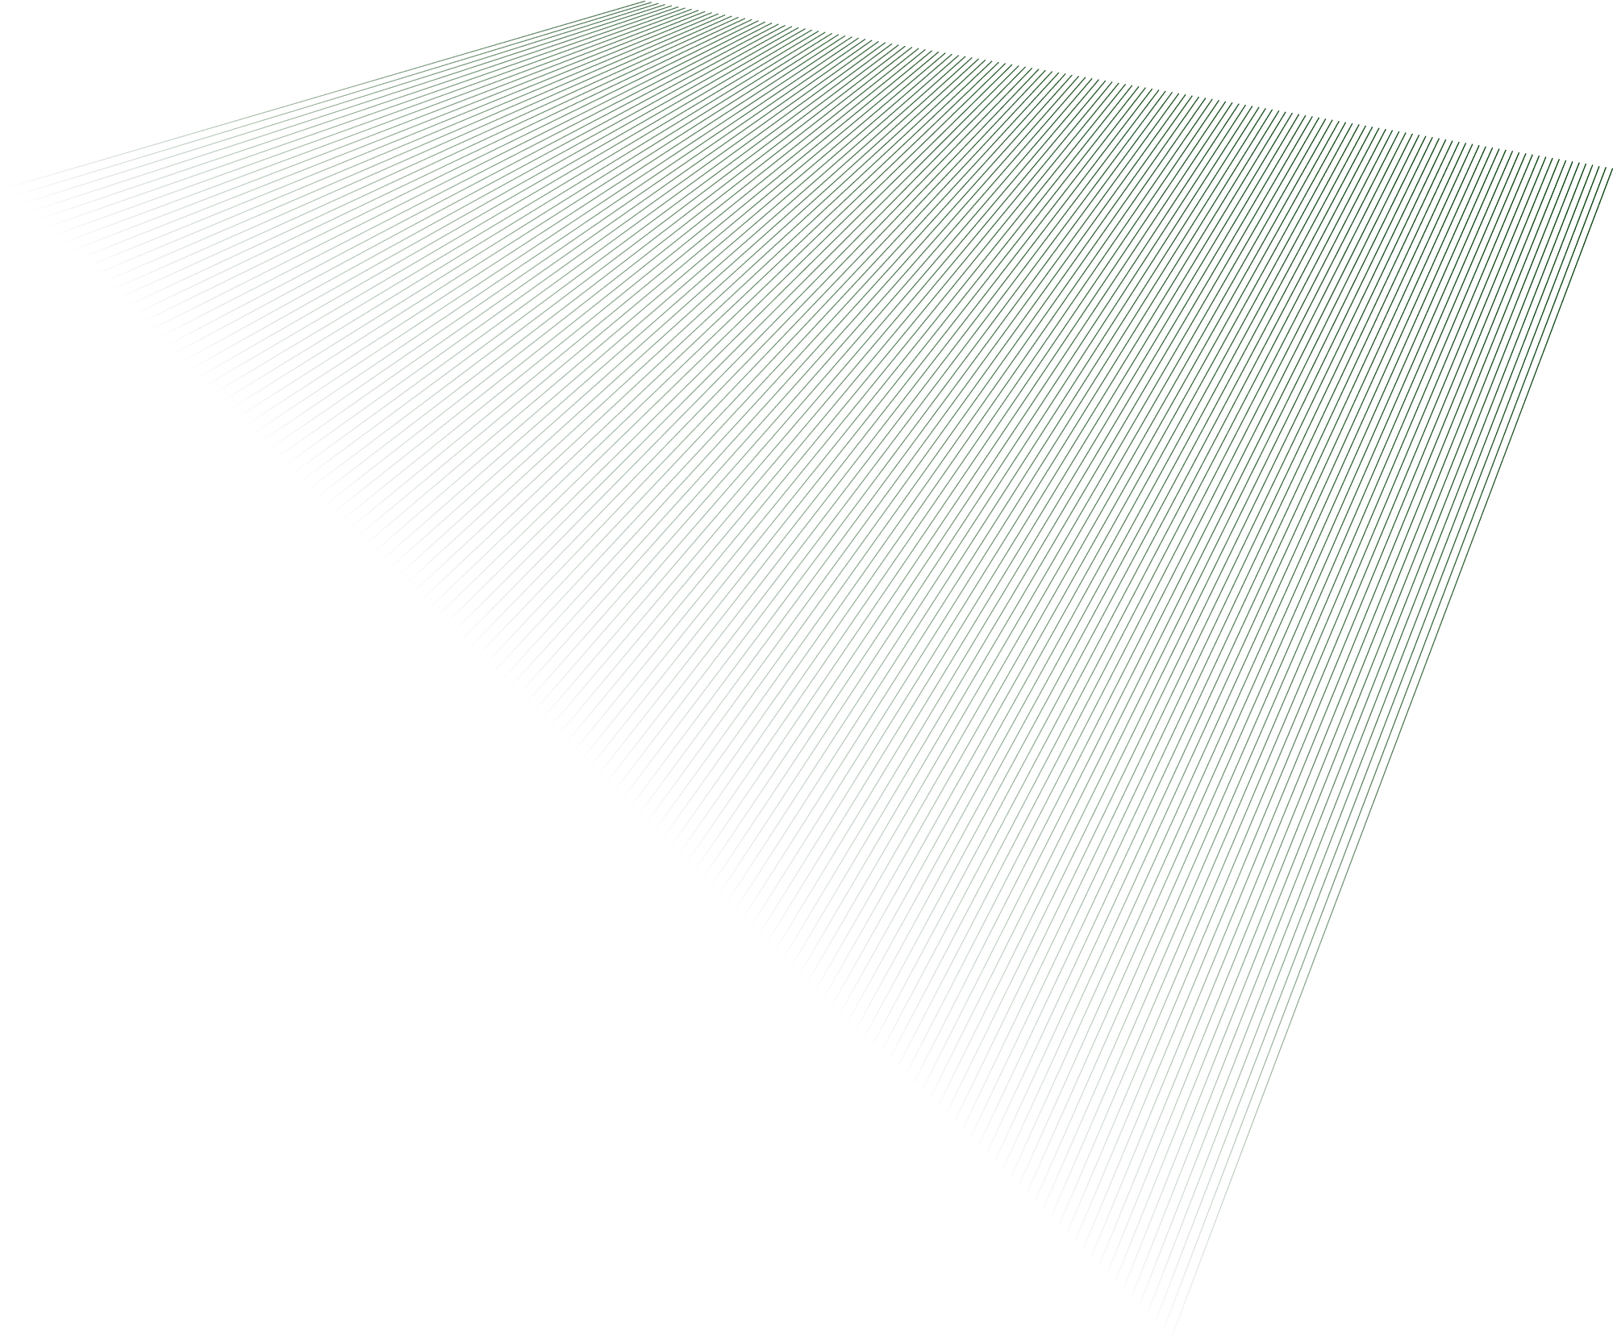
TEAM
Ian Ndolo Mwau SCT 211-0034/2022
Maureen Mukami SCT 211-0052/2022
David Nzambuli SCT 211-00682022
Pharis Kariuki SCT 211-0033/2022

Slide 3
INTRODUCTION
Objective:
Create a pie chart using OpenGL to visualize fruit preference data.
Demonstrate customization by applying fruit-resembling colors for each section.
Demonstrate grayscale conversion using OpenGL

Slide 4
PROBLEM 1 – PIE CHART FOR FRUIT PREFERENCES
Fruit | People
Orange | 36
Banana | 41
Kiwi Fruit | 19
Mango | 28
Grapes | 30
Ovacado | 16
Data Table:

Slide 5
PROBLEM1:FRUIT PREFERENCES PIE CHART
Objective
Draw a piechart with title "Fruit Preferences Survey"
Calculate percentages from the data.
Place labels outside each section.

Slide 6
FRUIT PREFERENCES PIE CHART
Code Walkthrough

Slide 7
CODE STRUCTURE OVERVIEW
Main Components:
display(): Renders the pie chart
reshape(): Maintains aspect ratio and orthographic projection
drawBitmapText(): Displays chart and label text
main(): Initializes GLUT and starts the rendering loop

Slide 8
DRAWING THE PIE CHART
Rendering Approach:
Calculate total of all values
For each slice:
Calculate percentage and angle
Draw slice using GL_TRIANGLE_FAN
Label each section outside the circle using trigonometry
Draw radial boundaries

Slide 9
IMPLEMENTATION USING C++
1. Slice Calculation
float sliceAngle = (values[i] / total) * 360.0f; // Convert % to angle
Uses trigonometry (sin/cos) to plot points.
2. Label Positioning
float labelX = centerX + cos(midAngle) * radius;
float labelY = centerY + sin(midAngle) * radius;
Special handling for “Banana” and “Kiwifruit” labels to improve readability.
3. Rendering Pipeline
display() → reshape() → main().
Output: Clean pie chart with dynamic resizing.

Slide 10
IMPLEMENTING A PIE CHART IN TKINTER (PYTHON)
Code Snippet:
for i, val in enumerate(values):
slicePercentage = val / total
sliceAngle = slicePercentage * 360
...
canvas.create_polygon(points, fill="black", outline="white")
Loops through data to compute angles.
Draws each slice using polygon-based wedges.
Adds white outlines for clarity.

Slide 11
CODE EXPLANATION
Positioning Labels
Code Snippet:
midAngle = startAngle + sliceAngle / 2 #Midpoint angle determines label placement.
labelX = centerX + (radius + label_offset) * math.cos(midRad)
labelY = centerY + (radius + label_offset) * math.sin(midRad)
if labels[i] in label_offsets:
labelX += offset_x
labelY += offset_y
#Uses custom x/y offsets for better positioning.

Slide 12
CODE EXPLANATION
Visual Styling
Code Snippet:
#Create canvas with black background
canvas = tk.Canvas(root, width=canvas_width, height=canvas_height, bg="black")
# Draw the outer white circle around the pie
canvas.create_oval(centerX - radius, centerY - radius,
centerX + radius, centerY + radius,
outline="white")
#Add chart title at the top
canvas.create_text(centerX, 50, text=chartTitle, fill="white", font=("Helvetica", 16))

Slide 13
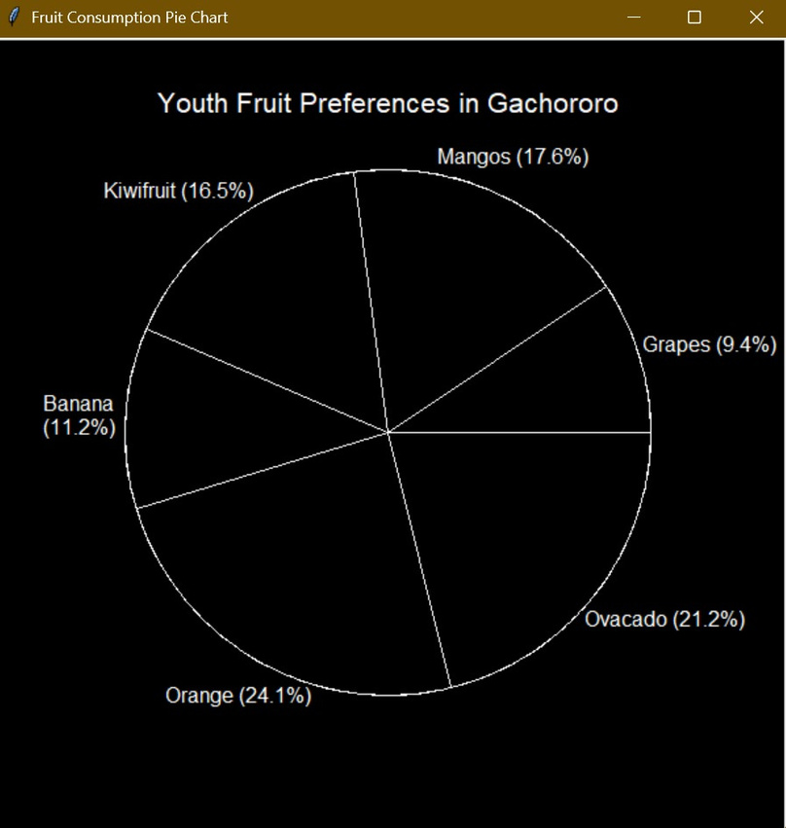
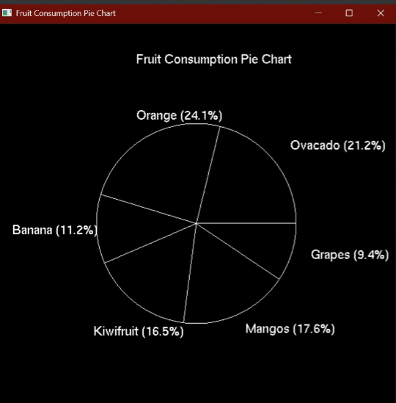
FRUIT PIE CHART
Output Using C++
Output Using Python

Slide 14
C++ VS. PYTHON COMPARISON
1. Text Rendering
C++
Python
// C++ (GLUT) glutBitmapCharacter(GLUT_BITMAP_HELVETICA_18, *c);
canvas.create_text(x, y, text=ch, fill="white", font=("Helvetica", 18))
2. Main Loop Structure
C++
Python
int main() {glutInit(&argc, argv);glutCreateWindow("Pie Chart");glutDisplayFunc(display); // Callback registration }
import tkinter as tk
def draw_pie_chart():
pass
def main():
root = tk.Tk()
root.title("Pie Chart")
canvas = tk.Canvas(root, width=600, height=600, bg="black")
canvas.pack()
draw_pie_chart()
root.mainloop()
if __name__ == "__main__":
main()

Slide 15
3. Label Repositioning Logic
C++
Python
// Adjust Banana label outward (extra space)if (std::string(labels[i]) == "Banana") {
labelRadius = radius + 0.42f; // Push further out}// Adjust Kiwifruit label leftwardif (std::string(labels[i]) == "Kiwifruit") {
labelRadius = radius + 0.20f; // Slightly out
labelX -= 0.09f; // Shift left}
if labels[i] == "Banana":
labelText = f"{labels[i]}\n({pct:.1f}%)" # "Banana" on the first line, percentage on the second
else:
labelText = f"{labels[i]} ({pct:.1f}%)"
#For "Banana", a newline is inserted
between the fruit name and its percentage value.
Key Takeaways
Same Output: Both versions produce identical visuals.
Syntax Differences:
C++: Explicit types, manual string formatting.
Python: Dynamic typing, f-strings.
Workflow: Python is quicker for prototyping; C++ offers more control.

Slide 16
PROBLEM 2 – FRUIT COLORED PIE CHART
Objective
Redraw the pie chart so that each section corresponds to the color of the fruit represented when ripest.

Slide 17
FRUIT-COLORED PIE CHART
Color Selection Explanation
Avocado: The greenish color (0.82, 0.81, 0.41) represents the distinctive flesh color of a ripe avocado.
Orange: A vibrant orange shade (0.93, 0.55, 0.14) that mimics the citrus fruit's characteristic color.
Banana: A bright yellow (1.0, 0.87, 0.35) selected to match a perfectly ripe banana skin
Kiwifruit: Deeper green (0.43, 0.51, 0.04) representing the kiwi's flesh once cut open
Mango: Orange-red shade (1.0, 0.51, 0.26) capturing the warm tones of a ripe mango
Grapes: Rich purple (0.44, 0.18, 0.66) mimicking the deep color of dark grapes

Slide 18
FRUIT COLORED PIE CHART
Code Walkthrough

Slide 19
FRUIT-COLORED PIE CHART
Data Structure Setup
C++
Python
// Data for the pie chart
static float values[] = {36.0f, 41.0f, 19.0f, 28.0f, 30.0f, 16.0f};
static const char *labels[] = {"Ovacado", "Orange", "Banana", "Kiwifruit", "Mangos", "Grapes"};
static const int NUM_SLICES = sizeof(values) / sizeof(values[0]);
# Survey data
fruits = ['Avocado', 'Orange', 'Banana', 'Kiwifruit', 'Mango', 'Grapes']
people = [36, 41, 19, 28, 30, 16]
total = sum(people) # Total number of responses
percentages = [round((count / total) * 100, 1) for count in people]
Color Array Definition
C++
Python
// Fruit colors (R, G, B)
static float colors[][3] = { {0.34f, 0.51f, 0.01f}, // Avocado
{1.0f, 0.65f, 0.0f}, // Orange
{1.0f, 0.87f, 0.35f}, // Banana
{0.65f, 0.89f, 0.18f}, // Kiwifruit
{1.0f, 0.51f, 0.26f}, // Mango
{0.44f, 0.18f, 0.66f} // Grapes;
# Fruit colors (R, G, B)
fruit_colors = [
(0.82, 0.81, 0.41), # Avocado
(0.93, 0.55, 0.14), # Orange
(1.0, 0.87, 0.35), # Banana
(0.43, 0.51, 0.04), # Kiwifruit
(1.0, 0.51, 0.26), # Mango
(0.44, 0.18, 0.66) # Grapes
]

Slide 20
FRUIT-COLORED PIE CHART
Window/Application Setup
C++
Python
// Window dimensions
const int WINDOW_WIDTH = 800;
const int WINDOW_HEIGHT = 800;
// Program entry point
int main(int argc, char **argv) {
glutInit(&argc, argv); // Initialize GLUT
glutInitDisplayMode(GLUT_DOUBLE | GLUT_RGB); // Double buffer and RGB color
glutInitWindowSize(WINDOW_WIDTH, WINDOW_HEIGHT); // Set window size
glutCreateWindow("Fruit Preferences Pie Chart"); // Create window
glClearColor(1.0f, 1.0f, 1.0f, 1.0f); // Set white background
glutDisplayFunc(display); // Register display callback
glutReshapeFunc(reshape); // Register reshape callback
glutMainLoop(); // Enter main event loop
return 0;
}
class PieChartApp:
def __init__(self, root):
self.root = root
self.root.title("Fruit Preferences Pie Chart")
# Set window size
self.root.geometry("800x800")
# Create the pie chart
fig = create_pie_chart()
# Create a canvas to display the pie chart
self.canvas = FigureCanvasTkAgg(fig, master=self.root)
self.canvas.draw()
self.canvas.get_tk_widget().pack(expand=True, fill=tk.BOTH)
# Close button
close_button = tk.Button(
self.root,
text="Close",
command=self.root.quit,
font=tkfont.Font(size=12)
)
close_button.pack(pady=10)

Slide 21
FRUIT-COLORED PIE CHART
Main Drawing Function
C++
Python
void display() {
// Calculate percentages
float total = 0.0f;
for (int i = 0; i < NUM_SLICES; ++i) {
total += values[I];
}
// Draw pie slices with colors
for (int i = 0; i < NUM_SLICES; ++i){
float sliceAngle = 360.0f * values[i] / total;
// Draw filled slices using fruit colors
glColor3f(colors[i][0], colors[i][1], colors[i][2]);
glBegin(GL_TRIANGLE_FAN);
// [Drawing code...]
glEnd();
}
}
def create_pie_chart():
# Create a figure and axis
fig, ax = plt.subplots(figsize=(6, 6), dpi=100)
# Create the pie chart
wedges, texts, autotexts = ax.pie(
people,
labels=[f"{f} ({p}%)" for f, p in zip(fruits, percentages)],
colors=fruit_colors,
autopct='',
startangle=90,
textprops={'fontsize': 10}
)
# Equal aspect ratio ensures the pie chart is circular
ax.axis('equal')
# Set the title
ax.set_title("Youth Fruit Preferences in Gachororo", pad=20)
return fig

Slide 22
FRUIT-COLORED PIE CHART
Label Positioning Logic
C++
Python
// Calculate label position
float midAngle = currentAngle + sliceAngle / 2.0f;
float midRad = midAngle * PI / 180.0f;
float labelRadius = radius + 0.15f;
// Adjust specific label positions if needed
if (i == 2) labelRadius += 0.1f; // Banana
if (i == 3) labelRadius += 0.05f; // Kiwi
float labelX = centerX + cos(midRad) * labelRadius;
float labelY = centerY + sin(midRad) * labelRadius;
# Label formatting is handled automatically by Matplotlib in the pie() function:
labels=[f"{f} ({p}%)" for f, p in zip(fruits, percentages)]
# This creates formatted labels like "Avocado (21.2%)" that are
# automatically positioned around the pie chart

Slide 23
FRUIT COLORED PIE CHART
C++ vs Python Implementation

Slide 24
FRUIT COLORED PIE CHART
Differences
Rendering Approach:
C++: Low-level rendering using triangle fans and manual angle calculations
Python(Matplotlib): High-level API with built-in pie chart function
UI Framework:
C++: GLUT (OpenGL Utility Toolkit) for window management
Python: Tkinter for window management with Matplotlib embedded
Text Rendering:
C++: Custom bitmap text rendering function
Python: Automatic text rendering with formatting options
Label Positioning:
C++: Manual positioning with angle calculations
Python(Matplotlib): Automatic label placement

Slide 25
FRUIT COLORED PIE CHART
Advantages and Disadvantages of C++(OpenGL) Implementation
Advantages
Disadvantages
Performance: Generally faster for real-time graphics and animations
Fine-grained control: More precise control over drawing and positioning
Portability: OpenGL is supported across multiple platforms
Learning value: Demonstrates fundamental graphics principles
Customization: Every aspect of the rendering can be customized
Complexity: Requires more lines of code for basic functionality
Manual calculations: Must manually calculate angles, positions, and text placement
Development time: Takes longer to implement
Maintenance: More complex code is harder to maintain
Lack of built-in features: No automatic label positioning or formatting

Slide 26
FRUIT COLORED PIE CHART
Advantages and Disadvantages of Python Implementation
Advantages
Disadvantages
Simplicity: Much shorter, more readable code
High-level API: Built-in pie chart function handles most details
Automatic formatting: Automatic label positioning and text formatting
Extensibility: Easy to add more features like legends, annotations, etc.
Interactive elements: Simple to add buttons and other UI controls
Export options: Built-in support for saving charts in various formats
Less control: Fewer options for customizing low-level details
Performance: Generally slower for real-time or animated visualizations
Dependencies: Requires multiple libraries (Matplotlib, Tkinter)
Learning curve: Requires understanding Matplotlib's specific API
Styling limitations: Some visual customizations may be difficult to achieve

Slide 27
FRUIT COLORED PIE CHART
Results & Comparison

Slide 28
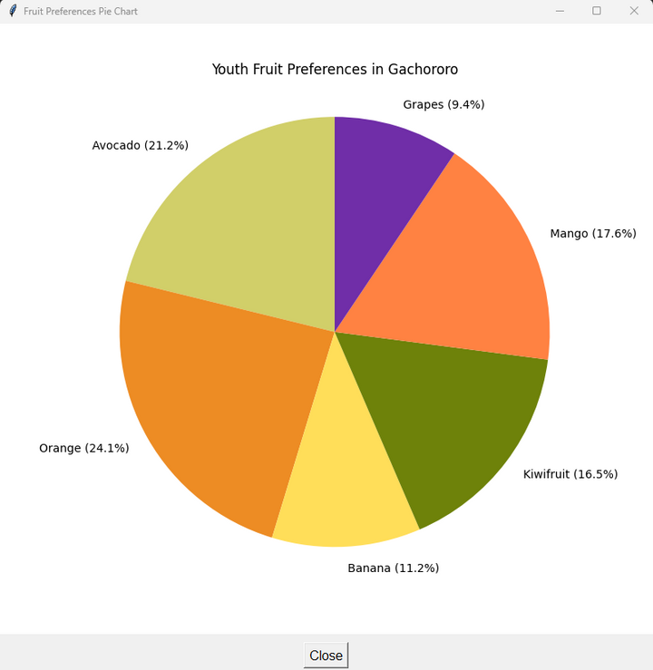
FRUIT-COLORED PIE CHART

Slide 29
FRUIT-COLORED PIE CHART
Visual Changes and Additions
Fruit-resembling colors create an intuitive association with data.
Maintained sufficient contrast between adjacent sections.
Adjusted label placement to prevent overlapping and improve readability.
Added slice borders in the C++ version for better visual separation

Slide 30
FRUIT-COLORED PIE CHART
Challenges
Label Positioning Challenges
Labels for adjacent small slices (Banana and Kiwifruit) were overlapping.
Solution
Implemented custom offset adjustments for specific slices.
Color Selection Challenges
Finding precise RGB values that closely match each fruit was difficult.
"Some fruits (like avocado) have different colors inside and out.
Solution
Researched RGB values representing each fruit's most recognizable color.
Tested multiple color options to ensure sufficient contrast between adjacent sections.

Slide 31
PROBLEM 3 – GRAYSCALE BACKGROUND IN OPENGL
Objective:
Convert chart background to grayscale using OpenGL.
Approach:
- Use luminance method to set grayscale values.
- Render the pie chart on a grayscale background.

Slide 32
THEORY – LUMINANCE PRESERVATION
Color Space Conversion Theory
Use the luminance formula to convert RGB to grayscale:
Gray = 0.299 * R + 0.587 * G + 0.114 * B
- This maintains perceived brightness across colors.

Slide 33
STEP-BY-STEP PROCESS
How Grayscale Conversion Works
Extract RGB values of each original color.
Apply the luminance formula to calculate the grayscale value.
Create new color where R = G = B = Gray.

Slide 34
OPENGL IMPLEMENTATION OVERVIEW
Converting Colors in OpenGL
For each color:
float gray = 0.299 * R + 0.587 * G + 0.114 * B;
glColor3f(gray, gray, gray);
Use grayscale values when rendering the chart background.

Slide 35
GRAYSCAL CONVERSION TABLE
Fruit | (R,G,B) | Gray Calculation | Grayscale Value
Avocado | (0.34, 0.51, 0.01) | 0.299×0.34 + 0.587×0.51 + 0.114×0.01 | 0.40
Orange | (1.0, 0.5, 0.0) | 0.299×1.0 + 0.587×0.5 + 0.114×0.0 | 0.59
Banana | (1.0, 1.0, 0.0) | 0.299×1.0 + 0.587×1.0 + 0.114×0.0 | 0.89
Kiwifruit | (0.45, 0.76, 0.23) | 0.299×0.45 + 0.587×0.76 + 0.114×0.23 | 0.61
Mangos | (1.0, 0.8, 0.0) | 0.299×1.0 + 0.587×0.8 + 0.114×0.0 | 0.77
Grapes | (0.5, 0.0, 0.5) | 0.299×0.5 + 0.587×0.0 + 0.114×0.5 | 0.21

Slide 36
Code Walk Through
1. Grayscale Colors Definition
C++
Python
// Grayscale colors using luminance formula: 0.299*R + 0.587*G + 0.114*B
static float grayscaleColors[][3] = {
{0.40f, 0.40f, 0.40f}, // Avocado
{0.59f, 0.59f, 0.59f}, // Orange
{0.89f, 0.89f, 0.89f}, // Banana
{0.61f, 0.61f, 0.61f}, // Kiwifruit
{0.77f, 0.77f, 0.77f}, // Mangos
{0.21f, 0.21f, 0.21f} // Grapes
};
# Convert colors to grayscale using luminance formula: 0.299*R + 0.587*G + 0.114*B
# Multiply by 3 to create RGB tuple (gray, gray, gray) for matplotlib compatibility
fruit_colors = [(0.299*r + 0.587*g + 0.114*b,) * 3 for r, g, b in original_colors]
2. Slice Coloring
C++
Python
// Set grayscale color for this slice
glColor3fv(grayscaleColors[i]); // Array pointeres
};
# Create pie chart with custom parameters
wedges, texts = ax.pie(
people,
colors=fruit_colors,
.....

Slide 37
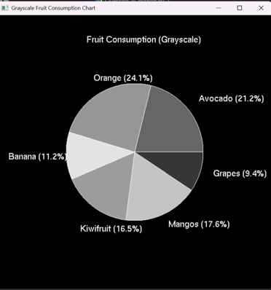
BEFORE AND AFTER VISUAL
Original colored chart background
Converted grayscale version

Slide 38
Takeaways:
Same Visual Output:
Both versions produce identical grayscale rendering:
Avocado = 0.4, Banana = 0.89, etc.
Maintenance:
Python version is easier to modify (e.g., adding new fruits)
C++ version offers better performance for complex visualizations

Slide 39
CONCLUSION
Summary of tasks achieved:
Pie chart representation of fruit preferences with percentages and external labels.
Color customization for realism.
OpenGL grayscale implementation.
Q&A

Slide 40
Thank you.

